Slide 1

Sales Performance Dashboard Overview
Using AdventureWorks Data
Viktorija Klimoviene

Slide 2
Overview of Sales Performance
Orders count: 31465
Customers count: 19119
Total sales: $ 141 M

Slide 3
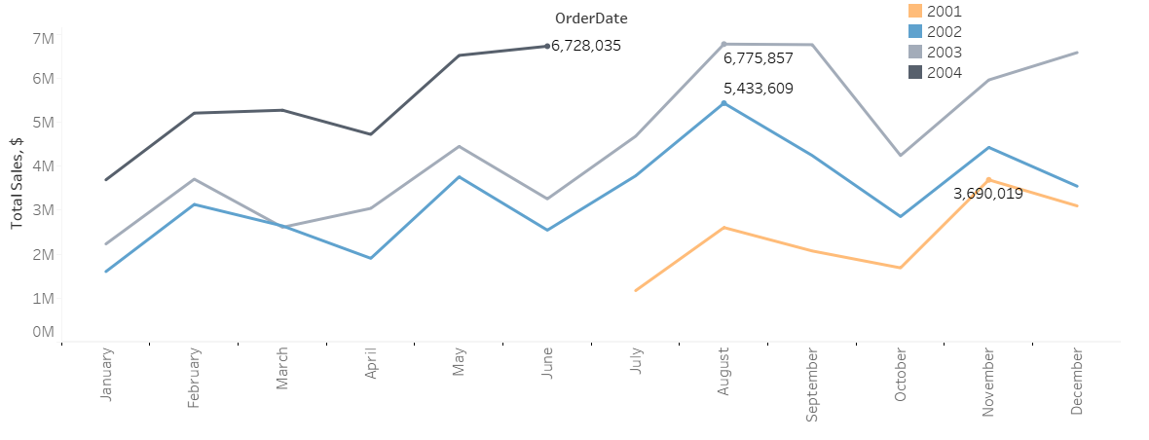
Sales Are Growing Each Year

Slide 4
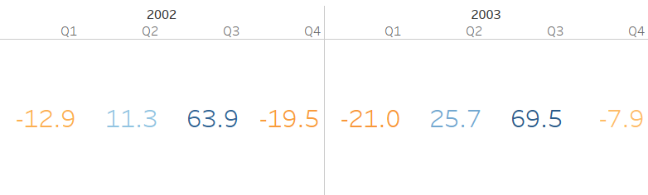
Highest Sales Achieved in 2003
Q2 – 25,7 %
Q3 – 69,5 %

Slide 5
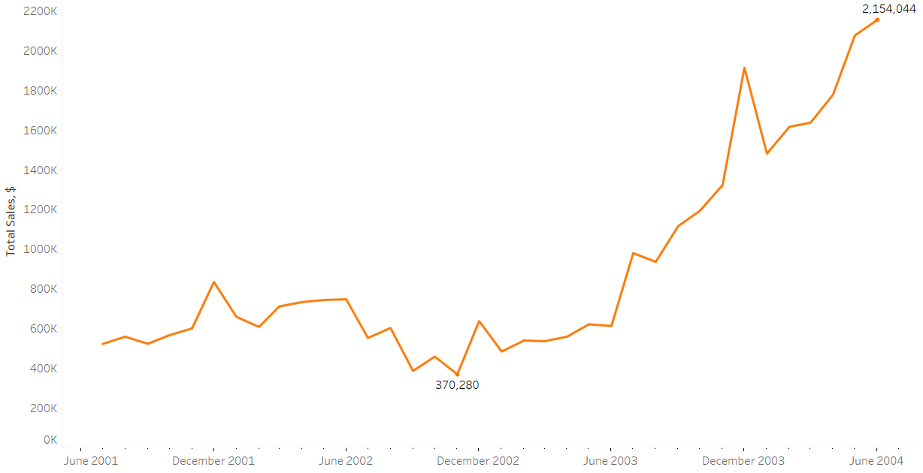
Online Sales Are Growing

Slide 6
Bike Category Leads in Sales
Bikes – 83,86 %
Components – 12,52 %
Clothing – 2,27 %
Accessories – 1,36 %

Slide 7
Returning Customers Generate Higher Sales
Returning customers – 94,68 % of total sales.
One-time customers – 5,32 % of total sales.

Slide 8
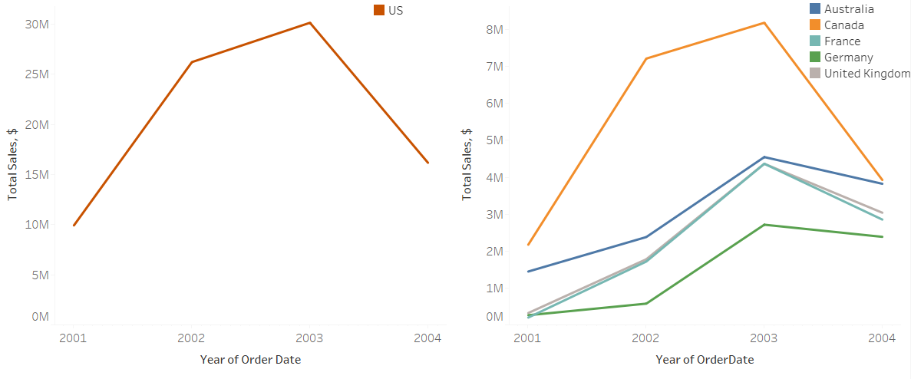
USA Leads in Sales

Slide 9
Summary & Opportunities
YoY Growth – Sales are consistently increasing year over year.
Online Orders Rising – Slow growth; opportunity to boost digital sales.
Returning Customers Spend More – Focus on keeping them loyal and coming back.
Geographic Expansion –USA leads; Canada shows strong growth potential.
Europe is growing steadily – Explore ways to accelerate performance.

